Slide 1
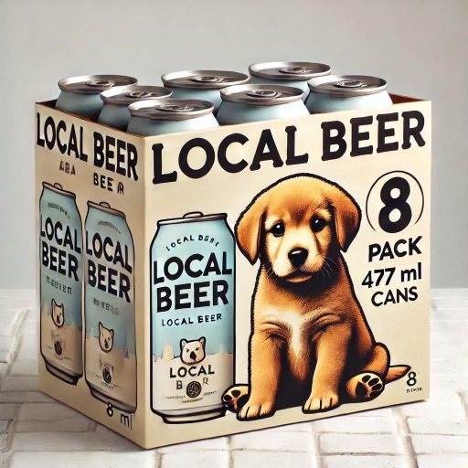
May 2025 – MBLL Driven Display Suggestion Slide - EXAMPLE
MBLL Driven Programs | Display Theme | # of SKUs | Notes
Local End Cap (Tier 1) | Beer - Spring | Up to 4 | Packaged Product (8-packs and up)
SKU | Suggested By | Product Description | Size | Price
1234 | Agent | LOCAL BEER 8/473C | 3784 | $25.99
Approved Liquor Mart Listing? | NO – SUBMITTED JAN 1, 2025
Additional Value (LTO, AIR MILES, Value Add) | YES - LTO
Excel Application Submitted? | YES
Why does this SKU fit the theme?
This is an expansion on our core SKUS. Looking to have available to private channel March 15, 2025.
Looking to launch in LM in April.
Overall brand has seen 150% YOY increase.
Perfect to stock up for cottage season!
Insert Product
Image Here

Slide 2
May 2025 – MBLL Driven Display Suggestion Slide
MBLL Driven Programs | Display Theme | # of SKUs | Notes
Local End Cap (Tier 1) | Beer - Spring | Up to 4 | Packaged Product (8-packs and up)
SKU | Suggested By | Product Description | Size | Price
Approved Liquor Mart Listing? | YES/NO
Additional Value (LTO, AIR MILES, Value Add) | YES/NO
Excel Application Submitted? | YES/NO
Why does this SKU fit the theme?
Sales data, historical performance, product attributes, tasting notes, etc.
Insert Product
Image Here

Slide 3
May 2025 – MBLL Driven Display Suggestion Slide
MBLL Driven Programs | Display Theme | # of SKUs | Notes
Loyalty End Cap (Tier 1) | Ready-to-Drink New Mixers | Up to 3 | Month-long at-shelf AIR MILES offer required
SKU | Suggested By | Product Description | Size | Price
Approved Liquor Mart Listing? | YES/NO
Month-Long At Shelf AIR MILES offer submitted? | YES/NO
Excel Application Submitted? | YES/NO
Why does this SKU fit the theme?
Sales data, historical performance, product attributes, tasting notes, etc.
Insert Product
Image Here

Slide 4
May 2025 – MBLL Driven Display Suggestion Slide
MBLL Driven Programs | Display Theme | # of SKUs | Notes
Social/Environmental End Cap (Tier 1-2) | Ready-to-Drink Sustainable | Up to 3 | Eco-Friendly Products (packaging/production, etc.)
SKU | Suggested By | Product Description | Size | Price
Approved Liquor Mart Listing? | YES/NO
Additional Value (LTO, AIR MILES, Value Add) | YES/NO
Excel Application Submitted? | YES/NO
Why does this SKU fit the theme?
Sales data, historical performance, product attributes, tasting notes, etc.
Insert Product
Image Here

Slide 5
May 2025 – MBLL Driven Display Suggestion Slide
MBLL Driven Programs | Display Theme | # of SKUs | Notes
Seasonal End Cap 1 (Tier 1-2) | Ready-to-Drink New | Up to 9 | Single-serve and 4-packs only
SKU | Suggested By | Product Description | Size | Price
Approved Liquor Mart Listing? | YES/NO
Additional Value (LTO, AIR MILES, Value Add) | YES/NO
Excel Application Submitted? | YES/NO
Why does this SKU fit the theme?
Sales data, historical performance, product attributes, tasting notes, etc.
Insert Product
Image Here

Slide 6
May 2025 – MBLL Driven Display Suggestion Slide
MBLL Driven Programs | Display Theme | # of SKUs | Notes
Seasonal End Cap 2 (Tier 1-3) | Ready-to-Drink Canned Cocktails | Up to 3 | Packaged products (8-packs and up)
SKU | Suggested By | Product Description | Size | Price
Approved Liquor Mart Listing? | YES/NO
Additional Value (LTO, AIR MILES, Value Add) | YES/NO
Excel Application Submitted? | YES/NO
Why does this SKU fit the theme?
Sales data, historical performance, product attributes, tasting notes, etc.
Insert Product
Image Here

Slide 7
May 2025 – MBLL Driven Display Suggestion Slide
MBLL Driven Programs | Display Theme | # of SKUs | Notes
Seasonal End Cap 4 (Tier 1-3) | Ready-to-Drink/Spirits Caesars | Up to 3 | Single-serve RTD and Spirits
SKU | Suggested By | Product Description | Size | Price
Approved Liquor Mart Listing? | YES/NO
Additional Value (LTO, AIR MILES, Value Add) | YES/NO
Excel Application Submitted? | YES/NO
Why does this SKU fit the theme?
Sales data, historical performance, product attributes, tasting notes, etc.
Insert Product
Image Here

Slide 8
May 2025 – MBLL Driven Display Suggestion Slide
MBLL Driven Programs | Display Theme | # of SKUs | Notes
Impulse Cold Box (39 stores) | Wine - Rosé | Up to 8 | Still and Sparkling
SKU | Suggested By | Product Description | Size | Price
Approved Liquor Mart Listing? | YES/NO
Additional Value (LTO, AIR MILES, Value Add) | YES/NO
Excel Application Submitted? | YES/NO
Why does this SKU fit the theme?
Sales data, historical performance, product attributes, tasting notes, etc.
Insert Product
Image Here

