Slide 1
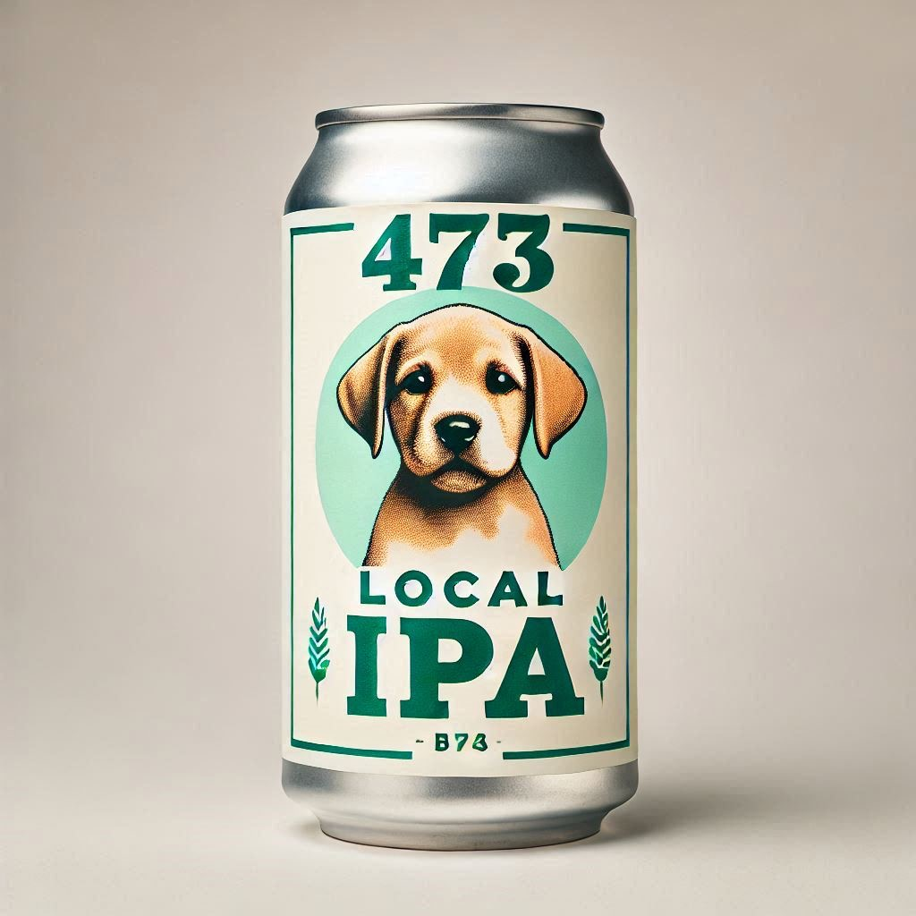
June 2025 – MBLL Driven Display Suggestion Slide - EXAMPLE
MBLL Driven Programs | Display Theme | # of SKUs | Notes
Local End Cap (Tier 1) | Beer - Summer | Up to 9 | Single-Serve IPAs only
SKU | Suggested By | Product Description | Size | Price
1234 | Agent | LOCAL IPA 473C | 473 | $3.89
Approved Liquor Mart Listing? | NO – SUBMITTED JAN 1, 2025
Additional Value (LTO, AIR MILES, Value Add) | YES – LTO
Excel Application Submitted? | YES
Why does this SKU fit the theme?
This is an expansion on our core SKUS. Looking to have available to private channel March 15, 2025.
Looking to launch in LM in April.
Overall brand has seen 150% YOY increase.
Insert Product
Image Here

Slide 2
June 2025 – MBLL Driven Display Suggestion Slide
MBLL Driven Programs | Display Theme | # of SKUs | Notes
Local End Cap (Tier 1) | Beer - Summer | Up to 9 | Single-Serve IPAs only
SKU | Suggested By | Product Description | Size | Price
Approved Liquor Mart Listing? | YES/NO
Additional Value (LTO, AIR MILES, Value Add) | YES/NO
Excel Application Submitted? | YES/NO
Why does this SKU fit the theme?
Sales data, historical performance, product attributes, tasting notes, etc.
Insert Product
Image Here

Slide 3
June 2025 – MBLL Driven Display Suggestion Slide
MBLL Driven Programs | Display Theme | # of SKUs | Notes
Loyalty End Cap (Tier 1) | Spirits - Canadian Whisky | Up to 3 | Month-long at-shelf AIR MILES offer required
SKU | Suggested By | Product Description | Size | Price
Approved Liquor Mart Listing? | YES/NO
Month-long At Shelf AIR MILES offer submitted? | YES/NO
Excel Application Submitted? | YES/NO
Why does this SKU fit the theme?
Sales data, historical performance, product attributes, tasting notes, etc.
Insert Product
Image Here

Slide 4
June 2025 – MBLL Driven Display Suggestion Slide
MBLL Driven Programs | Display Theme | # of SKUs | Notes
Social/Environmental End Cap (Tier 1-2) | All Categories Pride | Up to 9 | All categories
SKU | Suggested By | Product Description | Size | Price
Approved Liquor Mart Listing? | YES/NO
Additional Value (LTO, AIR MILES, Value Add) | YES/NO
Excel Application Submitted? | YES/NO
Why does this SKU fit the theme?
Sales data, historical performance, product attributes, tasting notes, etc.
Insert Product
Image Here

Slide 5
June 2025 – MBLL Driven Display Suggestion Slide
MBLL Driven Programs | Display Theme | # of SKUs | Notes
Seasonal End Cap 2 (Tier 1-3) | Wine - Sparkling | Up to 3 | All Sparkling
SKU | Suggested By | Product Description | Size | Price
Approved Liquor Mart Listing? | YES/NO
Additional Value (LTO, AIR MILES, Value Add) | YES/NO
Excel Application Submitted? | YES/NO
Why does this SKU fit the theme?
Sales data, historical performance, product attributes, tasting notes, etc.
Insert Product
Image Here

Slide 6
June 2025 – MBLL Driven Display Suggestion Slide
MBLL Driven Programs | Display Theme | # of SKUs | Notes
Impulse Cold Box (39 stores) | Wine - White | Up to 8 | Canadian White Wine (excluding BBIC)
SKU | Suggested By | Product Description | Size | Price
Approved Liquor Mart Listing? | YES/NO
Additional Value (LTO, AIR MILES, Value Add) | YES/NO
Excel Application Submitted? | YES/NO
Why does this SKU fit the theme?
Sales data, historical performance, product attributes, tasting notes, etc.
Insert Product
Image Here

